Slide 1
Computer Architecture Tutorial 2
2015 / 4 / 7
First Submission: 2015 / 5/ 9
Second Submission: 2015 /5 / 16

Slide 2
Outline
Project 1 – Issues
Testing Script & Golden Simulator
Project 2 - Pipeline
Concept
Output & Input
Implementation Notes
Notes:
Why?

Slide 3
Download the New Appendix-B from Project 2 on iLMS

Slide 4
Project 1 - Issues
Sll $0 $0 C, if C != 0 then write error Else NOP
Valid testcase can not lead to number overflow by beq, bne.
beq , bne , slt use C operation ( >,<,=…etc)

Slide 5
Testing Script & Tool

Slide 6
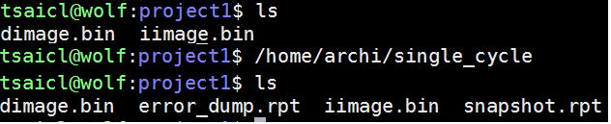
Run Golden Simulator
Type /home/archi/single_cycle
Refer to the .rpt file

Slide 7
Test your folder structure
Execute the “test_script.py”
Type python test_script.py
Enter your student ID
Enter the project number
You should check whether you get 9 “OK” conditions

Slide 8
Project 2 - Pipeline
Improve instruction-level parallelism(ILP)

Slide 9
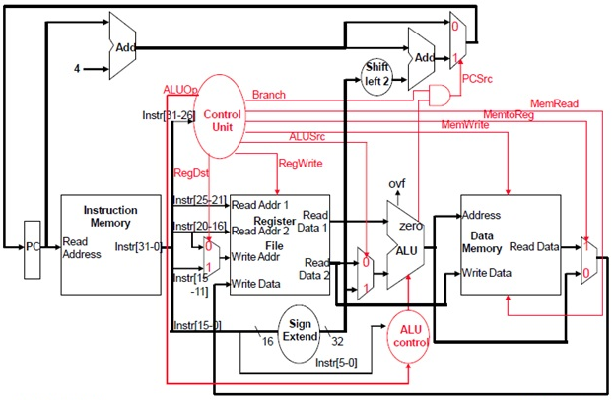
Single Cycle Data Path
Low design complexity,
Low ILP ( instruction-level parallelism ), How to improve?
Notes:
為什麼要介紹 Data Path ?
Revisit single cycle的simulator，但是在上次的課程中，我們加入Data Path的觀念，
反應硬體實際實作，幫助導入pipeline的結構。
為什麼 Design Complexity 比較低呢？在一次 clock 就完成完整一個指令 ( instruction) 的工作。

Slide 10
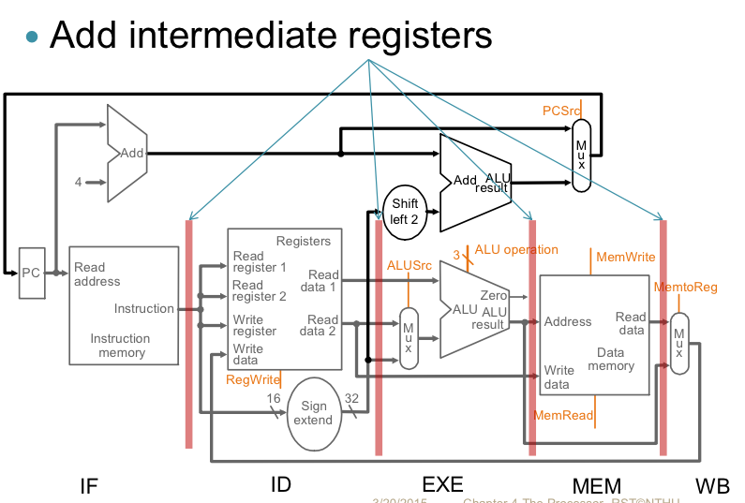
Pipeline Stage
EX/DM
DM/WB
EX
DM

Slide 11
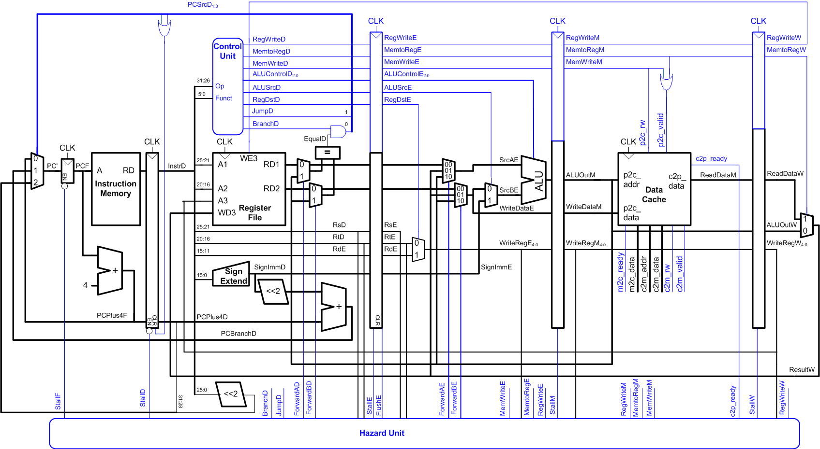
Pipeline Datapath & Control ( Project 2 Objective)
Higher design complexity
High ILP(instruction-level parallelism)
Notes:
1, 為達到增加instruction-level parallelism，

Slide 12
Pipeline 5 Stages
IF
instruction fetch
PC+4
ID
Read Register File
Sign extension
Control unit decode
Hazard detect, Branch/Jump detect
EX
ALU / Branch
DM
Access data memory
WB
Write value to Register File
Forwarding Unit
EX/DM to ID
EX/DM to EX
DM/WB to EX
independent of instruction type
dependent of instruction type R-type, I-type, J-type

Slide 13
Project 2 Objective Solving Pipeline Hazard
Data hazard
Stall , Ex: lw is not write back yet.
Forwarding ( appendix C-2 )
EX/DM to ID
EX/DM to EX
DM/WB to EX
Control hazard
Flush (appendix C-2 ex5 )

Slide 14
Input & Output
Input: same as project 1
Output:
snapshot.rpt
Contents of registers
Mnemonic in pipeline stage
whether stalled in next cycle
whether forwarding in this cycle
error_dump.rpt
Appendix D ( Be careful about error order )

Slide 15
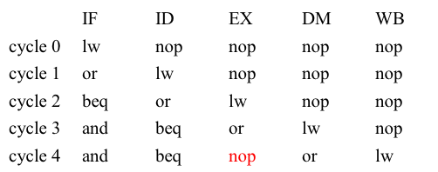
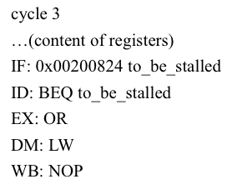
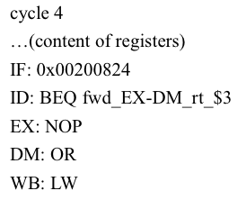
snapshot trace
lw $2, 0($3)
or $3, $1, $4
beq $2, $3, some_line
and $1, $1, $0
Detect stalled
EX/DM
Cycle 3 is done!
Forwarding
Execute cycle 4
detect right after

Slide 16
Test Case Design
Your test case need to include:
One control hazard
One data hazard resolved by inserting NOPs
One data hazard cleared by forwarding
Number of NOPs and forwarding path is unlimited.
< 500,000 cycles
(Valid rule is same as Project 1)

Slide 17
Implementation Notes
NOP: sll $0, $0, 0 (bit-stream 0x00000000 recomm.)
Initialization: The pipeline is initialized with NOPs in all stages
Terminates: after five “halt”, otherwise invalid
Simulation Order (highly recommended)
WB ➔ DM ➔ EX ➔ ID ➔ IF
To avoid re-execution of some stages

Slide 18
Submission
Upload to iLMS
Name executable file pipeline
File name format : (more detail in spec)
Program: studentID_02.tar.gz
Report: studentID_report.pdf
Check your Program Package pass the testing script
Or check your can untar /make …etc by yourself

Slide 19
Submission (2)
Create a folder named studentID_02 under /home/archi/studentID
In the folder, please provide the following two folders and corresponding files required:
simulator : contains your「Makefile」,「README」, and 「source code files」.
Your Makefile should support the following two functions: make – to build your simulation environment make clean – to erase from the build tree the files built by make all.
testcase : contains your test case files.

Slide 20
Submission (3)
Finally, compress the folder studentID_02 as studentID_02.tar.gz
Compress
tar -zcvf 學號_02.tar.gz 學號_02
Decompress (TA will use this )
tar -zxvf 學號_02.tar.gz
StudentID_02
(folder)
testcase
(folder)
simulator
(folder)

Slide 21
tar 指令

Slide 22
tar 指令
壓縮： tar -zcvf 學號_01.tar.gz 學號_01
解壓縮： tar -zxvf 學號_01.tar.gz
-c ：建立一個壓縮文件的參數指令
-x ：解開一個壓縮文件的參數指令
-z ：是否同時具有 gzip 的屬性
-v ：壓縮的過程中顯示文件
-f ：使用檔名，在 f 之後要立即接檔名

Slide 23
Evaluation
Report: (Same as project 1)
Test Case: (Same as project 1)
Simulator :TA will use linux diff to compare snapshot.rpt and error_dump.rpt for grading

Slide 24
Test Environment
ssh studentId@140.114.75.140
Data Transmission: FileZilla , scp, ftps
Any related issue and problem
Please post your issue / problem on iLMS

Slide 25
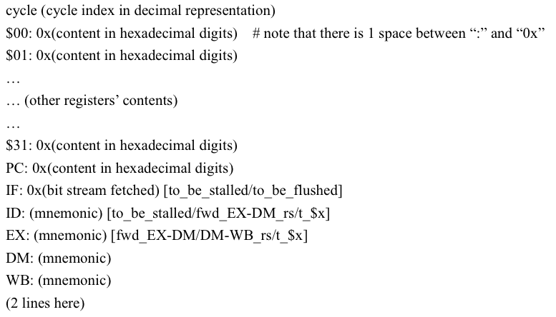
snapshot.rpt format
Contents of registers
Pipeline Stage

